Slide 1
Mushroom Classification
DSE I2100 - Final Project
Spring 2021
Robert Moss
Iman Abakoyas
Rodrigo Guerra

Slide 2
Why So Important?
Mushroom research and mushroom related industries in the misted of major growth.
Johns hopkins launched a center for the study of of psychedelic compounds found in mushrooms as treatment for mental health disorders [1]
Various regions have decriminalized psychoactive mushrooms [2,3] (and more cities will inevitable follow).
Industries like micro textiles and mushroom-based supplements are growing fast as the demand for eco-friendly products increases in the US [4].
There is also renewed research into Mushrooms as a source for antibiotics capable of treating the emerging antibiotic resistant bacteria [5].
[1] https://hub.jhu.edu/2019/09/04/hopkins-launches-psychedelic-center/
[2] https://www.newsweek.com/dc-initiative-81-psychedelics-magic-mushrooms-decriminalized-1576502
[3] https://www.oregonlive.com/pacific-northwest-news/2021/03/governor-appoints-board-to-oversee-oregons-new-psychedelic-mushroom-program.html
[4] https://smallfarms.cornell.edu/projects/mushrooms/specialty-mushroom-cultivation/defining-the-specialty-mushroom-industry/
[5] https://www.ncbi.nlm.nih.gov/pmc/articles/PMC4483641/

Slide 3
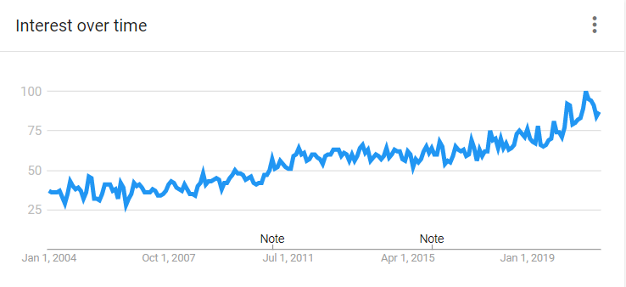
Increased Public Interest
Interest has recently hit an all time high in google searches and it appears this trend will continue [fig.1].
[Figure 1] - https://trends.google.com/trends/explore?date=all&geo=US&q=mushroom

Slide 4
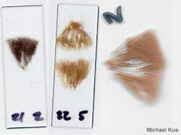
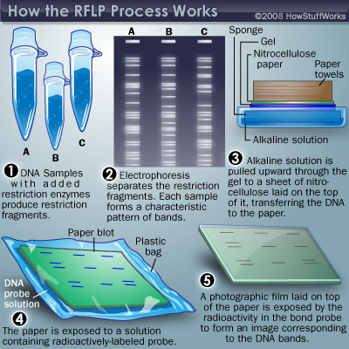
Why So Difficult?
One genus of mushroom can have multiple phenotypic expressions making traditional classification by physical description difficult [6]. This requires expertise.
The only morphological way to classify mushrooms is by microscopic evaluation of spore prints [7].This requires equipment and expertise.
Deep changes occur quickly in mushroom genomes making modern hierarchical genetic classification untenable[6]. Also requires equipment and expertise.
Due to the heterogeneity of approaches to fungal taxonomy and the complexity of lineage-dependent evolutionary processes, there are no simple strategies to unambiguously identify fungi [6].]
[6] https://www.ncbi.nlm.nih.gov/pmc/articles/PMC7539958/
[7]https://www.ncbi.nlm.nih.gov/pmc/articles/PMC7353689/
https://www.mushroomexpert.com/studying.html
https://science.howstuffworks.com/dna-profiling.htm

Slide 5
What is Needed?
Because there is no single unified system in place for identifying mushrooms any self-contained system that is able to accurately and precisely predict a mushrooms species, i.e. medical importance based on a physical description can be just as widely adopted as genetic linkage-mapping or spore print classifications systems.
If we can develop a system that does not use expensive and complicated equipment that requires expertise we have a system of classification that is cheaper, simpler and more widely available.
Enter Machine Learning?
Given a mushrooms characteristics and the characteristics of the mushroom species common to the area could, we using machine learning, accurately and precisely classify that mushroom?

Slide 6
DataSet
The mushroom dataset we will be exploring comes from the UCI machine learning repository (https://archive.ics.uci.edu/ml/datasets/mushroom).
The dataset is synthetic. Including descriptions of hypothetical 8124 mushrooms corresponding to 23 species of the Agaricus and Lepiota Families. The genus and species names are not included.
The dataset is drawn from the Audubon Society Field Guide to North American Mushrooms (1981).
The data set was made to guide foragers to distinguish between edible and poisonous mushrooms.

Slide 7
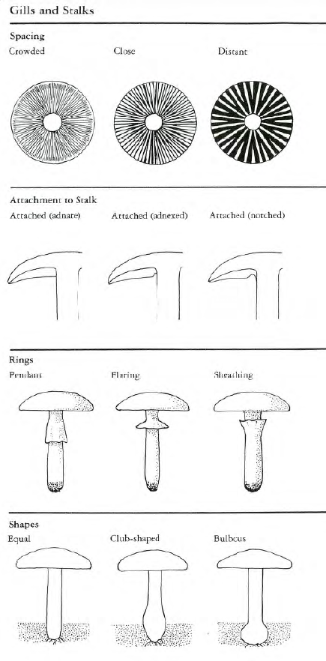
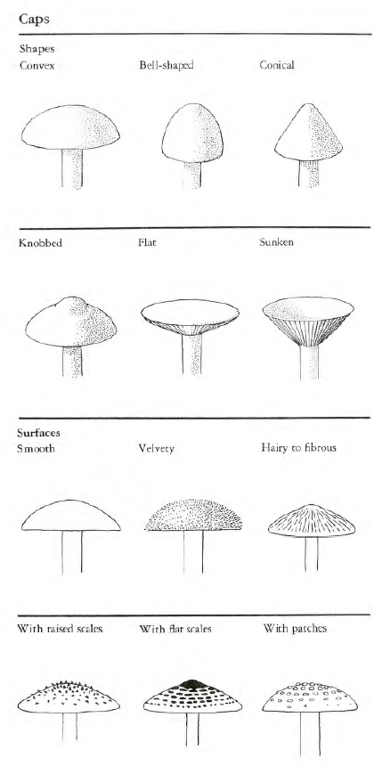
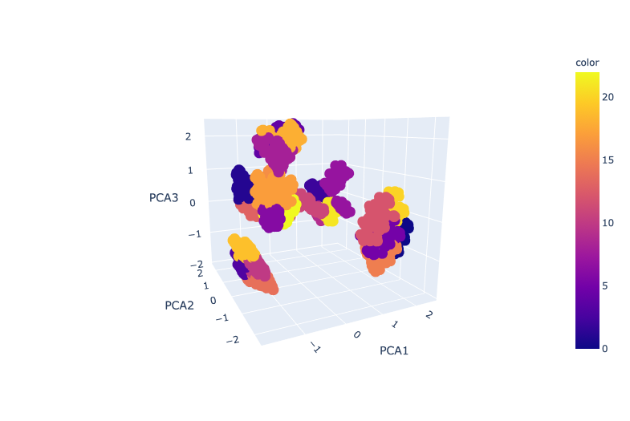
Objective 1: Clustering
Remove outlier samples
Run clustering algorithms on the UCI dataset, optimizing for 23 well defined clusters (we know the authors included 23 species)

Slide 8
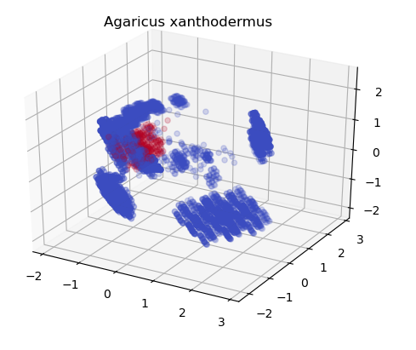
Objective 2: Assigning Species to Clusters
Label a few samples manually
Run a semi-supervised learning model to assign labels to our clusters.
PCA3
PCA2
PCA1

Slide 9
EDA
Unsupervised Learning
Semi - supervised Learning
Comparisons to Supervised Learning
Bar plots are used to gauge the correlation of categorical variables
Outliers were detected and removed using DBSCAN. PCA was run after this (36 PC were chosen.
Categorical data was encoded using a dummy encoding scheme
KMeans was run and served as a baseline for clustering performance.
Agglomerative Clustering was run. A better clustering was obtained
Silhouette metric was used to determine the quality of the clusters
A small set of labeled data was created (~100 instances)
Label Spreading algorithm was applied and labeled clusters were outputted
Silhouette metric was used to determine the quality of the clusters
Logistic Regression was trained with the small subset of labeled datasets. Labels were predicted on the original unlabeled data.
Accuracy was a metric of how much more information was obtained using semi-supervised learning

Slide 10
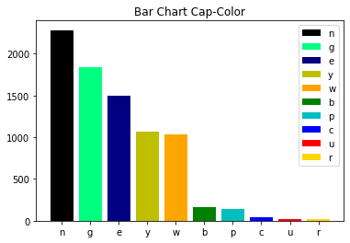
EDA of UCI Unlabelled Mushroom Data Set
Traditional EDA approaches for categorical data.
Bar charts were made to look at the distribution of feature expressions [fig.2].
Three features were removed:
Viel type - only one feature expression for entire population.
Edible - important medical trait did not want accessible to machine learning algorithms.
Stalk Root - over 30% missing values.
Figure[2] Bar Chart of Cap-Color feature distribution

Slide 11
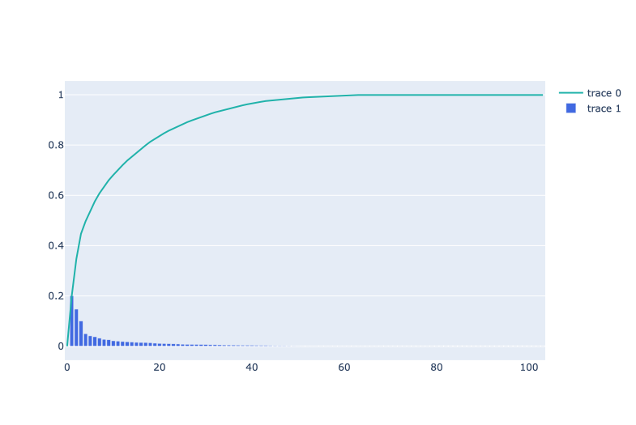
Feature Transformation & Outlier Detection
Ordinal features dummied using OneHotEncoder all other features transformed using getDummies.
T-SNE cluster visualization made using KMeans Clustering, dataset[fig.4].
DBSCAN was used to remove ~5% of the dataset it classified as outliers.
PCA run on complete dataset. At 36 PCA’s 95% of population variance contained in dataset[fig.3]
Cumulative Variance vs PCA
Cumulative Variance
PCA
Figure[3] - Cumulative Variance vs PCA

Slide 12
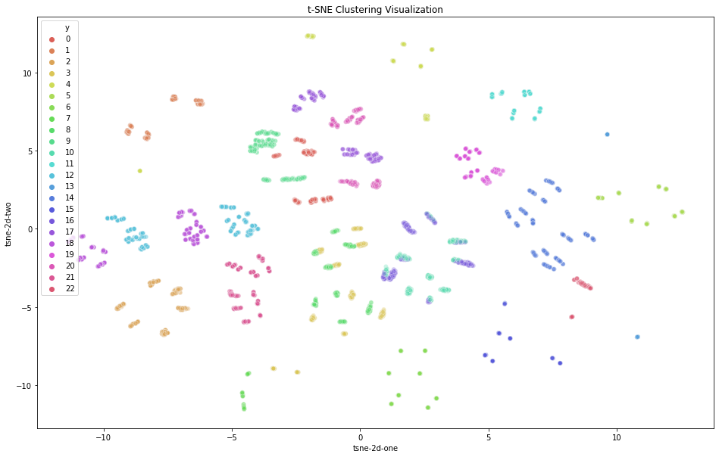
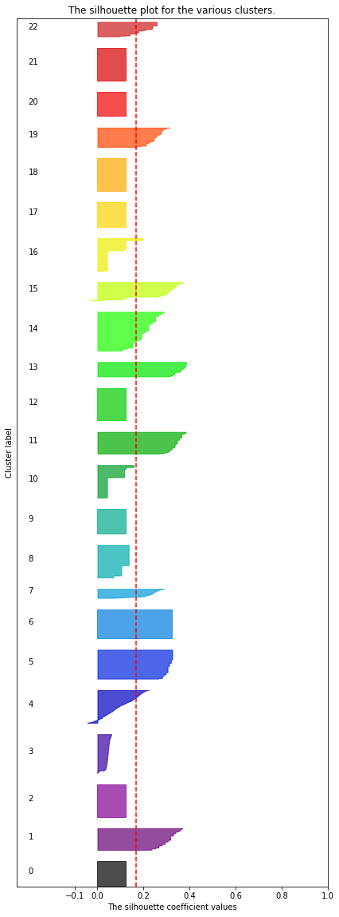
figure [4] - 2D t-SNE plot from KMeans Cluster
Figure[5] - Silhouette Plot of KMeans Clusters

Slide 13
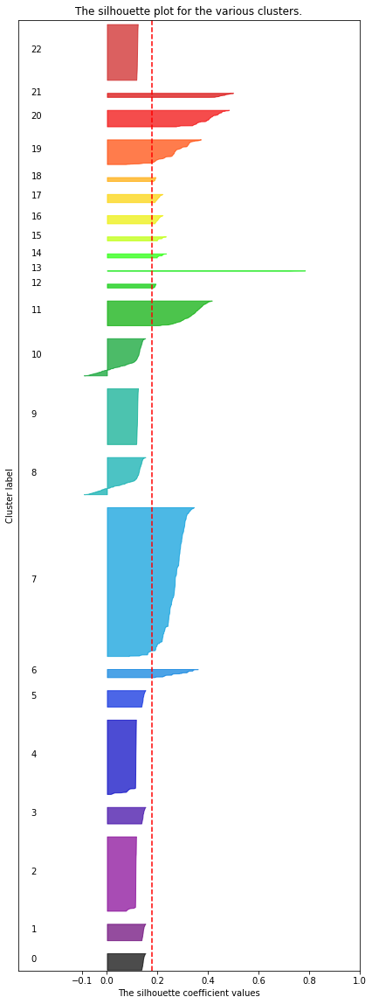
Agglomerative Clustering
Preformed on the outlier reduced dataset. Baseline evaluation gave a silhouette score of ~0.19.
GridSearch was run on the Agglomerative Clustering to optimized the affinity and linkage parameters to silhouette score.
Optimized hyperparameters of ‘l2’ and “single” for affinity and linkage respectively[fig.6]
Figure [6] - Silhouette Plot of Optimized Agglomerative Clustering

Slide 14
We have clusters, so what?
Unsupervised learning showed that there are some well defined clusters that make up our data set (we can see them on the previous silhouette diagram).
The following questions arise:
Can we label each cluster with a species?
How can we be sure that our labeling was correct?
Would our results differ from a supervised model given that we had all the labels for our dataset?
Should we manually label each of our 8000+ data points?

Slide 15
Semi-Supervised Learning
Getting our mushrooms manually labeled to support a fully supervised model would be very time consuming and we might require the opinion of various mycologists. Mushrooms are hard to classify even for experts!
Semi-supervised algorithms allow us to learn from our unlabeled data by using a very small subset of labeled samples, if at least one of the following assumptions is satisfied [1]
Points that are close to each other are more likely to share a label
Data tend to form discrete clusters
Vapnik, V.; Chervonenkis, A. (1974). Theory of Pattern Recognition (in Russian). Moscow: Nauka. cited in Chapelle, Schölkopf & Zienin 2006, p. 3

Slide 16
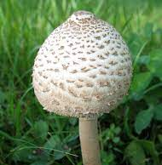
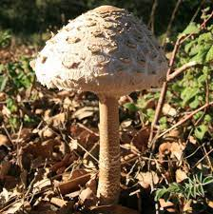
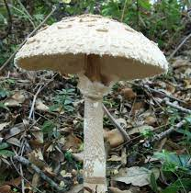
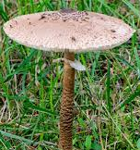
Semi-Supervised Learning
It is a fair assumption that mushrooms samples from the same species share similar properties.
Further, from the our unsupervised learning results, we can also assume that our data tends to form discrete clusters.
We are set, right?...
Lepiota Procera

Slide 17
Synthetically labeled dataset
How do we go about getting labeled samples?
We could take some of our unlabeled data and label them ourselves. Unfortunately, we are not mycologists :(
Instead, we opted from extracting the the desired features from a mushroom sample of known species.

Slide 18
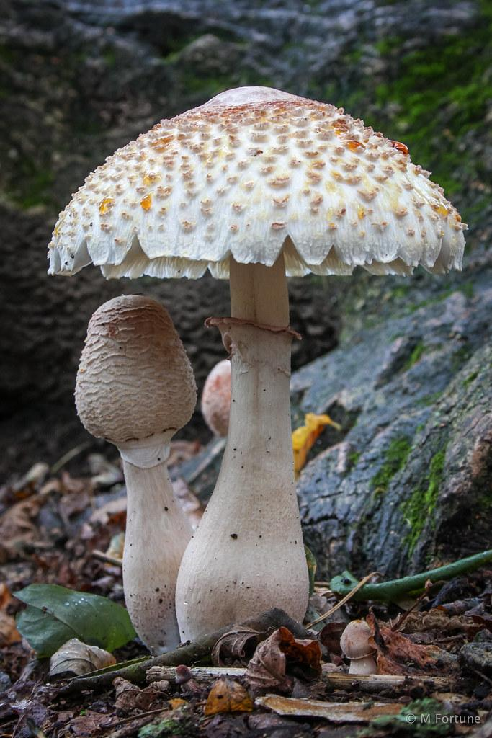
Synthetically labeled dataset
Example (only 5 features):
Species: Lepiota americana
Edible? : Edible (e)
Cap shape: Knobed (k), Convex (x), Flat (f)
Cap surface: Smooth (s), Scaly (y)
Cap color: Pink (p), Cinnamon (c), Red (e), Brown (n), Buff (b)
Bruises?: True (t)
Lepiota americana

Slide 19
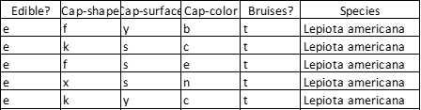
Synthetically labeled dataset
We made a simple algorithm that randomizes each feature and outputs a representative sample of a given species.
This is done 5 times for each of 23 species, yielding a total of 115 labeled data points.
Figure 7: Five samples, each a potential member of the Lepiota americana species.

Slide 20
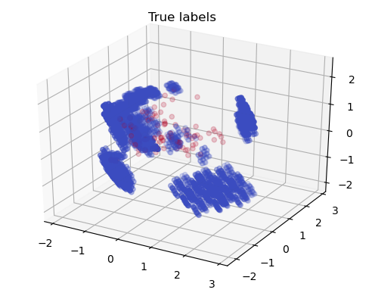

Semi-Supervised Learning
We are now ready to train a semi-supervised model:
~8000 specimens of unknown species
115 specimens of known species
Data-cleaning has been done as part of unsupervised experiments
Figure 8: (Left) Red points are the data we labeled, blue points are the data with unknown species. (Right) Outliers on our data
PCA3
PCA3
PCA2
PCA2
PCA1
PCA1

Slide 21
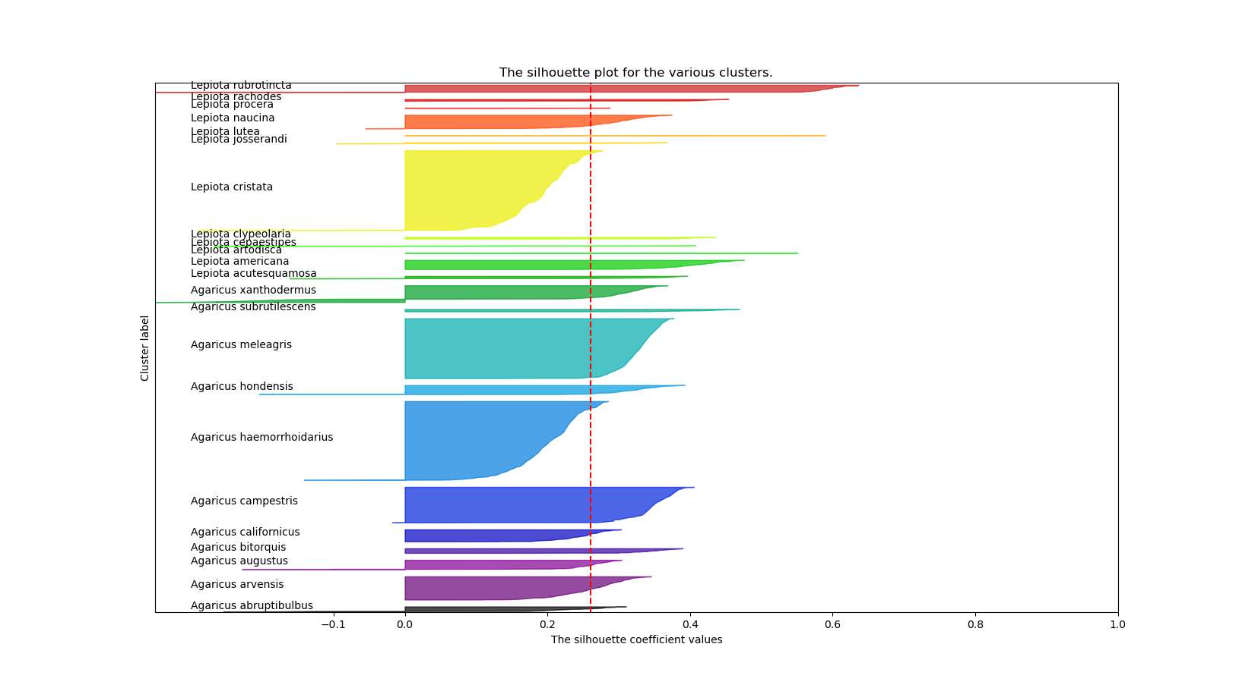
Figure 9: Silhouette plot of Label Spreading output.

Slide 22



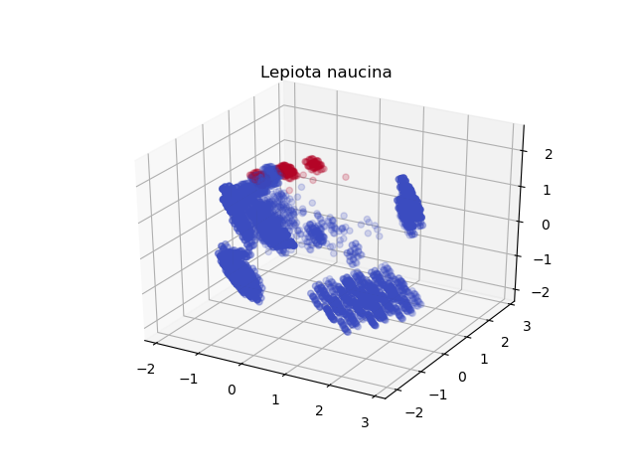


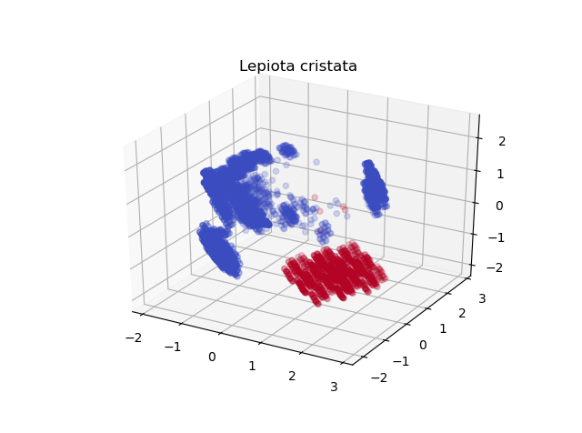

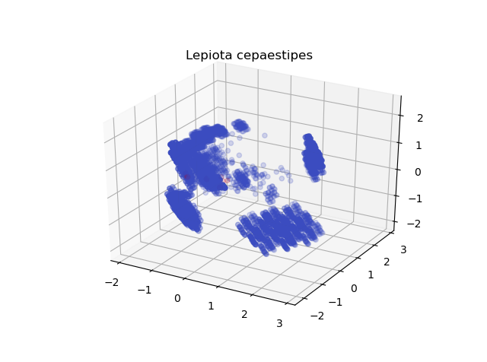

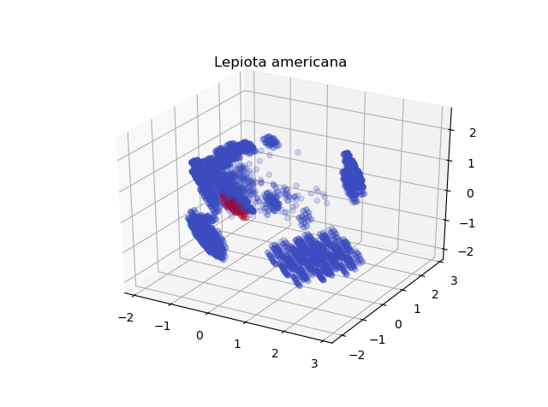

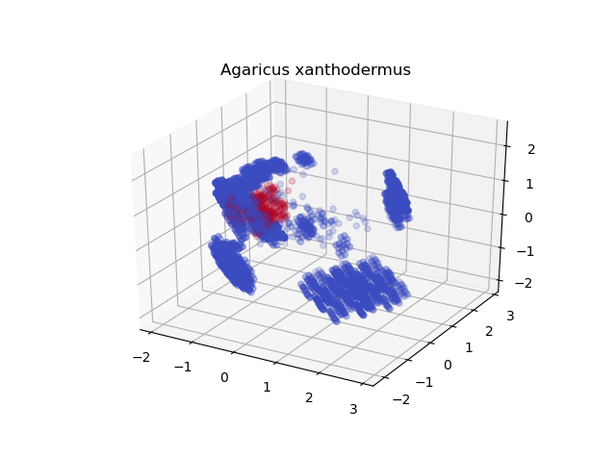

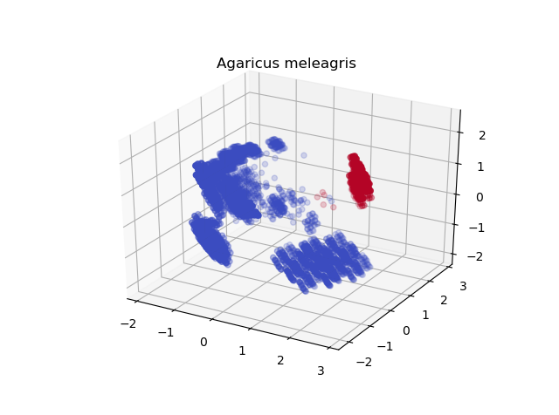

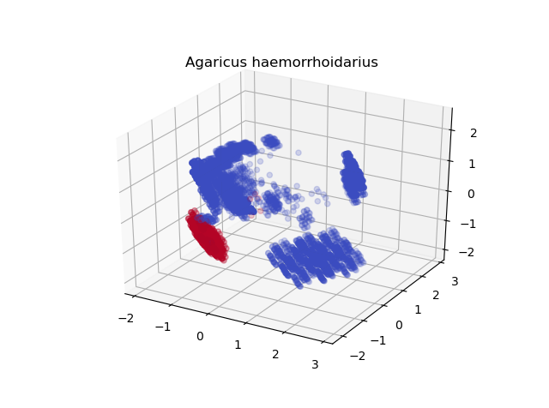
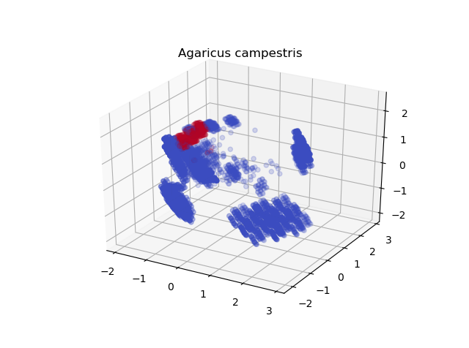
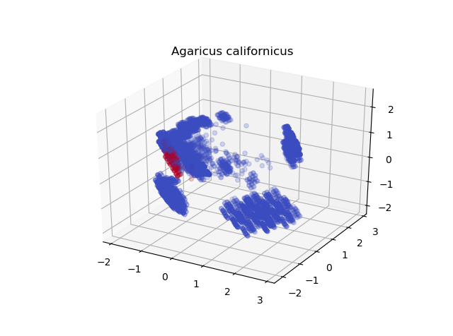


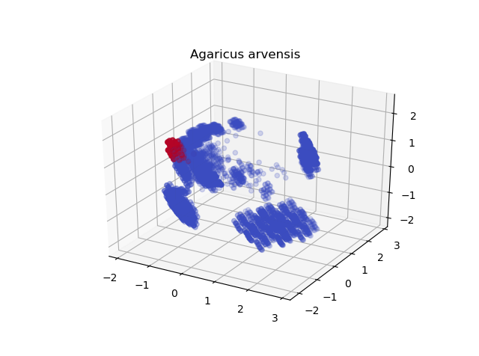
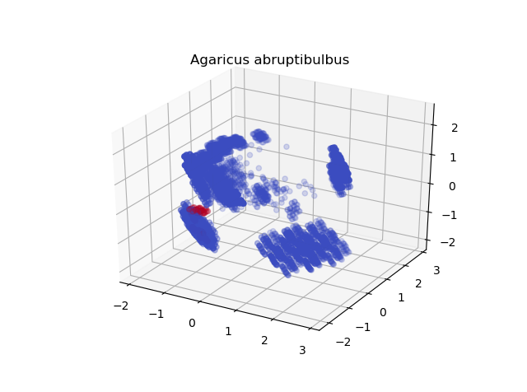
PCA3
PCA2
PCA1

Slide 23
Results
Eight of our clusters were smaller than expected. This might be due to a few reasons
Our assumption that the unlabeled dataset follows an uniform distribution of species is wrong (possible).
Our data set contains less species than originally thought (unlikely)
Some species are too similar to be distinguished with the features present. If a species’s features are a subset of another species’ features, our model cannot distinguish them (likely)

Slide 24
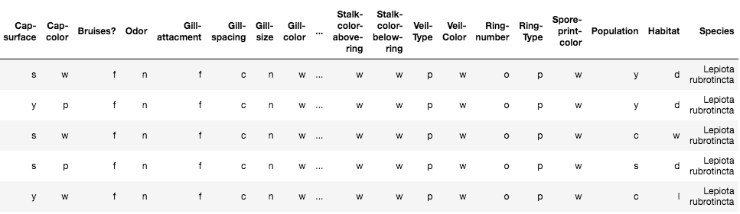
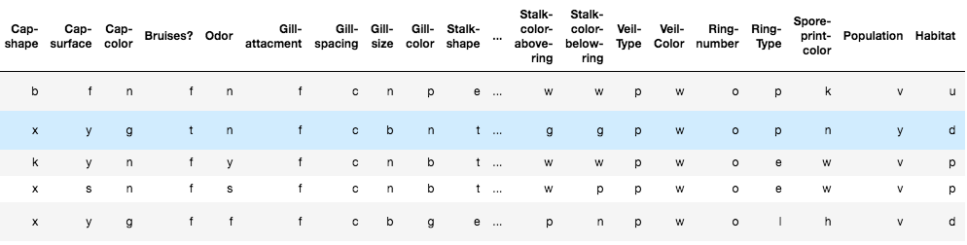
Supervised Learning Comparison
Compared the baseline supervised learning with results from unsupervised and semi-supervised learning.
Labeled Data Unlabeled Data

Slide 25
Check how the results between supervised and semi-supervised learning differ in their predictions.
Took training set from the labeled data (~ 100 samples) and testing set from the unlabeled data (~8000 samples).
Species for the testing set were taken from semi-supervised learning results
Could training on ~100 mushroom samples been enough to capture the complexity of the different species?

Slide 26
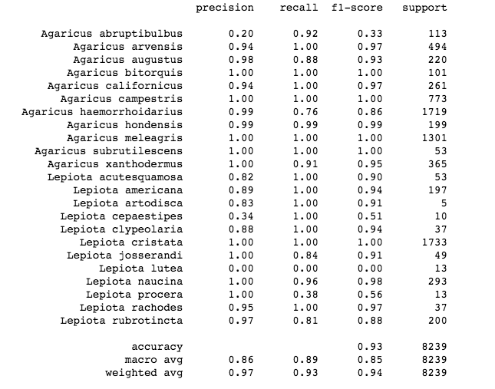
Accuracy Scores
Logistic regression gave us an
accuracy of 89%.
Did a grid search cv with
different values of c ranging
from 0.001-0.5 to increase our
accuracy.
With c=0.12, accuracy score got
up to 93%.

Slide 27
Conclusions
Agglomerative and KMeans clustering was able to differentiate 23 distinct clusters based on the physical descriptions of the mushrooms in the UCI dataset.
Semi-supervised algorithm shows that some clusters can be assigned a species, but not all of them. We need more relevant features!
More than 100 labeled samples (and the help of a few mycologists) are required to attempt a supervised models.

